Slide 1


Trending Video Analysis
Rowdy Rooster Team
Boya Li , David Moon, EunJeong Heo

Slide 2

Contents
Introduction
Question to Answer
Project/Dataset Summary
Data Cleanup & Exploration
Data Analysis
Conclusion

Slide 3



Introduction
x
Why YouTube is important?
As of 2020, there are 2+ billion logged-in monthly users out there. The number of channels grew more than 23%, and the number of channels that earn $10K USD per year or more grew by 50%. 70% of viewers bought from a brand after seeing it on YouTube.
YouTube is the second most visited website in the world!
Objective:
With continued increase in revenue earned by channels through Youtube, identifying hot topics
and key variables that contribute to a video’s success is very important.
Analyze trending video data over the previous two years to discover possible variations
between variables across separate English speaking countries/ regions.
* Motivation & Summary Slide
* Define the core message or hypothesis of your project.
* Describe the questions you asked, and _why_ you asked them
* Describe whether you were able to answer these questions to your satisfaction, and briefly summarize your findings
Notes:
https://blog.hubspot.com/marketing/youtube-demographics
More than 500 hours of video are uploaded every minute on YouTube, so the competition is fierce.
With continued increase in revenue earned by channels through Youtube, identifying hot topics and key variables that contribute to a video’s success is very important. Analyze trending video data over the previous two years to discover possible variations between variables across separate English speaking countries/ regions.

Slide 4

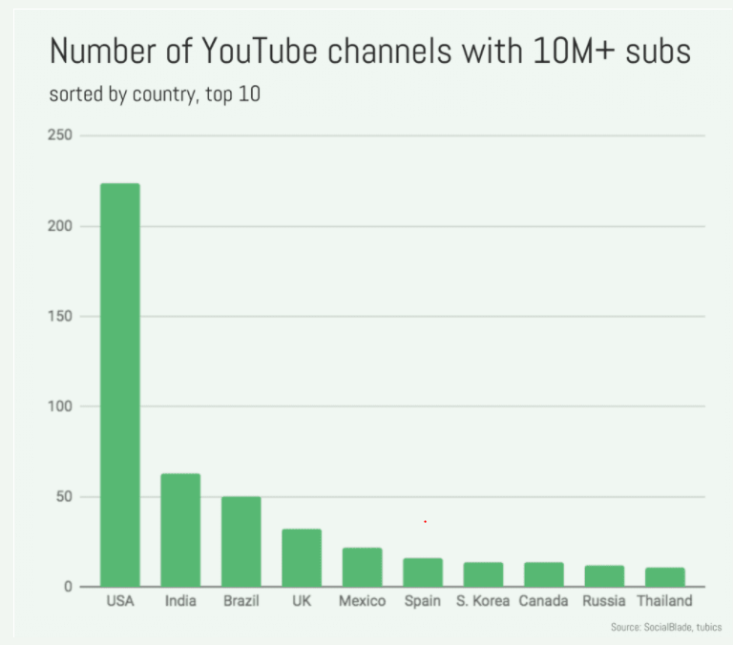
Introduction
x
10 Crucial YouTube Ranking Factors
Channel Keywords
Video Title
Video Description
Video Tags
Video Quality
User Experience Metrics
Watch Time
View Count
Thumbnails
Closed Captions & Subtitles
(www.searchenginepeople.com)
Notes:
https://www.searchenginepeople.com/blog/16071-youtube-ranking-algorithm.html

Slide 5

Question to answer
x
What factors lead YouTube videos to a trending video?
Objective
Identify hot topics and key variables that contribute to a video’s success.
Analyze trending video data over the previous two years to discover possible variations between variables across separate English-speaking countries/ regions.
Notes:
https://www.searchenginepeople.com/blog/16071-youtube-ranking-algorithm.html
With continued increase in revenue earned by channels through Youtube, identifying hot topics and key variables that contribute to a video’s success is very important. Analyze trending video data over the previous two years to discover possible variations between variables across separate English speaking countries/ regions.

Slide 6


Project/Dataset Summary
x
Hypothesis and Findings
There are key differences in trending video metrics among the three English speaking regions
Title length, tag length, published time, and category show similar trends across the three countries
The variables might have the similar trend for the trending videos among those three English speaking countries
Notes:
* Motivation & Summary Slide
* Define the core message or hypothesis of your project.
* Describe the questions you asked, and _why_ you asked them
* Describe whether you were able to answer these questions to your satisfaction, and briefly summarize your findings

Slide 7



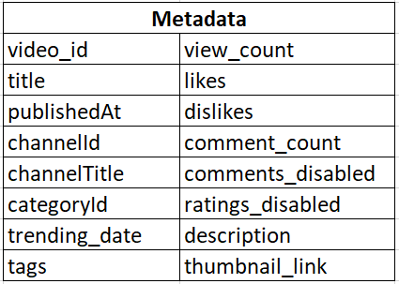
Dataset Summary
x
Dataset used
YouTube Trending Video Dataset (updated daily)
https://www.kaggle.com/rsrishav/youtube-trending-video-dataset
Key Features
Metadata
3 countries selected (US, GB, CA)
200 trending videos a day over 1.5 years
Over 100k videos per country
11 variables included

Slide 8

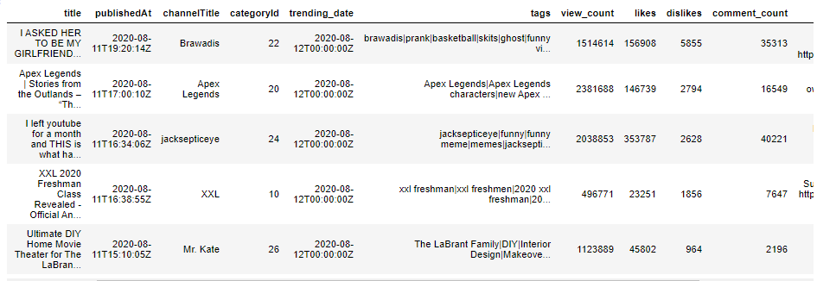
Dataset Summary
Data Cleanup & Exploration
x
Dataset Exploration

Slide 9

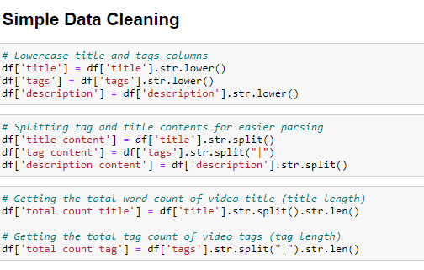
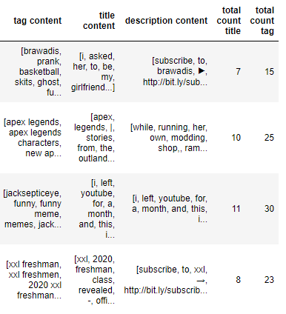

Data Cleanup & Exploration
Data Cleaning
Convert all characters to lowercase and split title and tags for easier parsing
Count splitted title/ tags words into items in a list then get total count

Slide 10
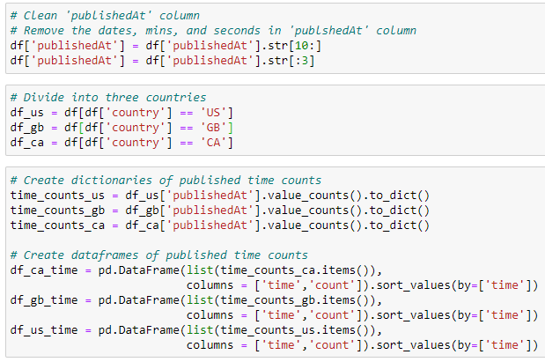
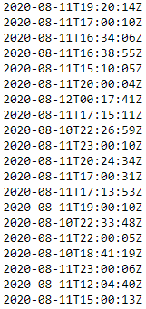
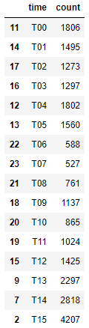
Data Cleanup & Exploration
Data Cleanup & Exploration
Data Cleaning
Convert ‘publishedAt’ and ‘categoryId’ columns into simple readable format
Create dataframes out of counts afterwards

Slide 11

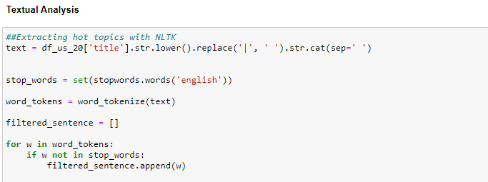
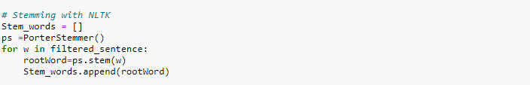
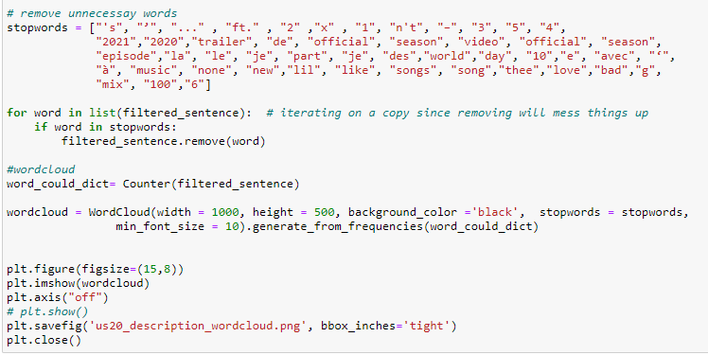
Data Cleanup & Exploration
Textual Analysis with NLTK Libraries
Tokenization
: is the process of breaking up a given text into units called tokens.
Stop words
:are a set of commonly used words in any language.
Stemming
:is the process of reducing inflected words to their word stem, base or root form—generally a written word form
Notes:
* Data Cleanup & Exploration
* Describe the exploration and cleanup process
* Discuss insights you had while exploring the data that you didn't anticipate
* Discuss any problems that arose after exploring the data, and how you resolved them
* Present and discuss interesting figures developed during exploration, ideally with the help of Jupyter Noteboo

Slide 12
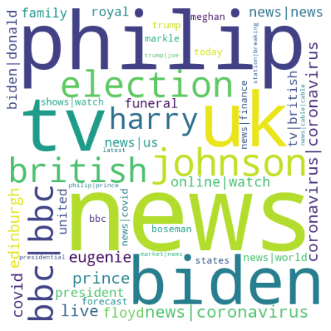
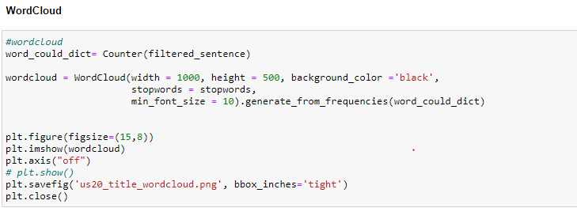
Data Cleanup & Exploration
Textual Analysis – World Cloud
Notes:
* Data Cleanup & Exploration
* Describe the exploration and cleanup process
* Discuss insights you had while exploring the data that you didn't anticipate
* Discuss any problems that arose after exploring the data, and how you resolved them
* Present and discuss interesting figures developed during exploration, ideally with the help of Jupyter Noteboo

Slide 13

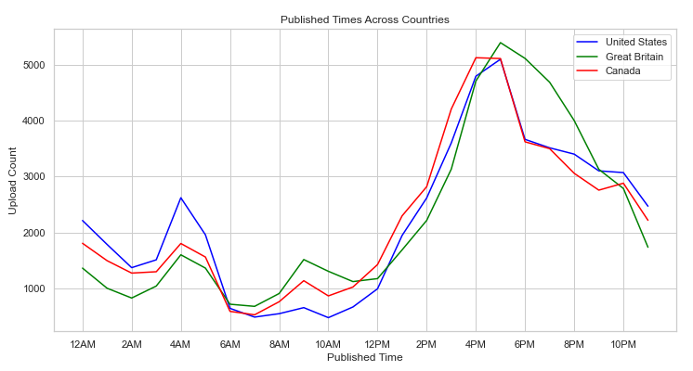

Data Analysis
x
Published Times Across Countries
Similar published times across all countries
Most videos published between 3:00 PM - 7:00 PM
Note
slight peak at 4:00 AM

Slide 14

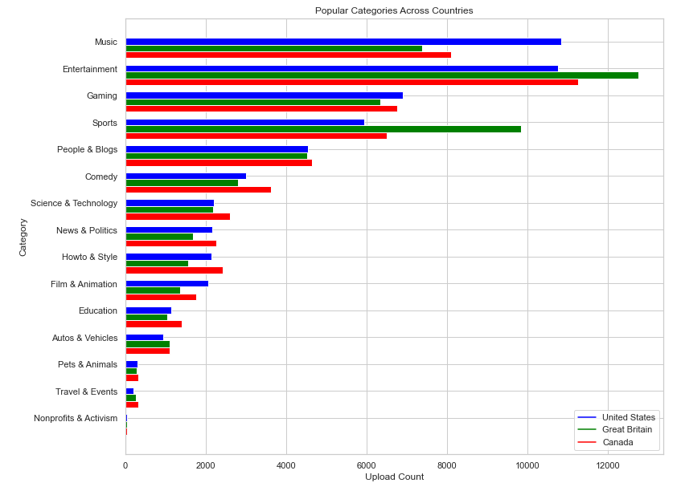
Data Analysis
x
Published Categories Across Countries
Similar category rank across all countries
Note
Great Britain shows Sports category as second highest in popularity
Music, Entertainment, Gaming, and Sports makes up over 50% of all video categories

Slide 15

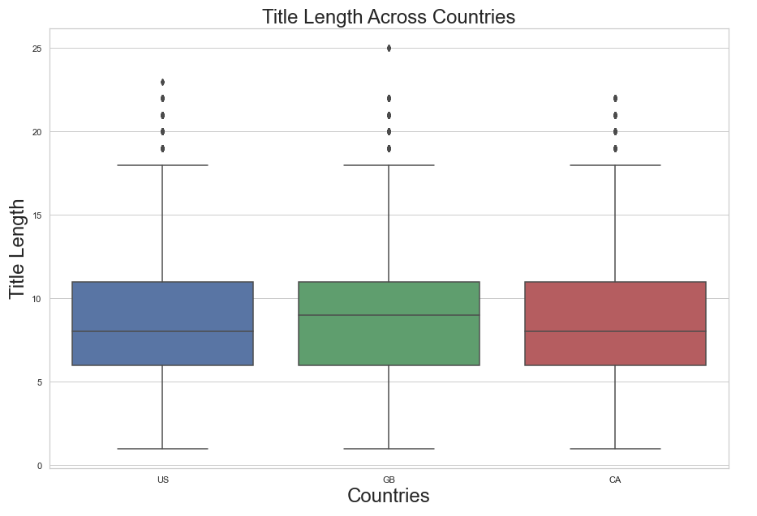
Data Analysis
x
Title Length Across Countries
Lower Quartile | 6.0
Upper Quartile | 11.0
Inter Quartile | 5.0
Median of title length
US | GB | CA
8.0 | 9.0 | 8.0
Note
Values below -1.5 above 18.5
could be outliers

Slide 16
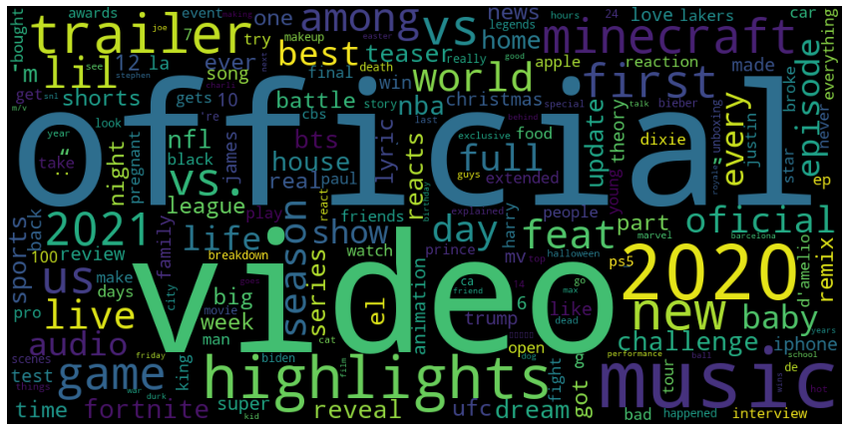
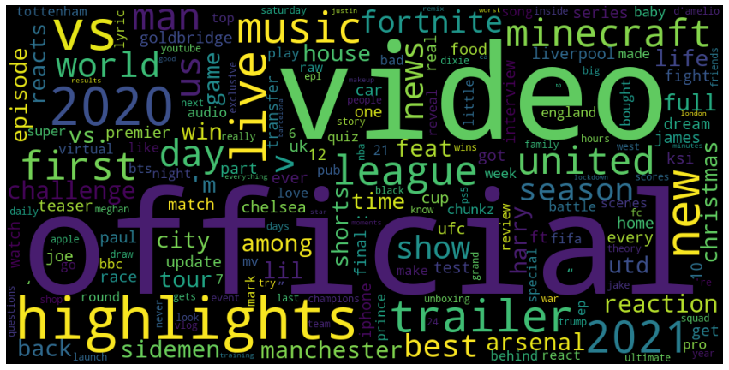
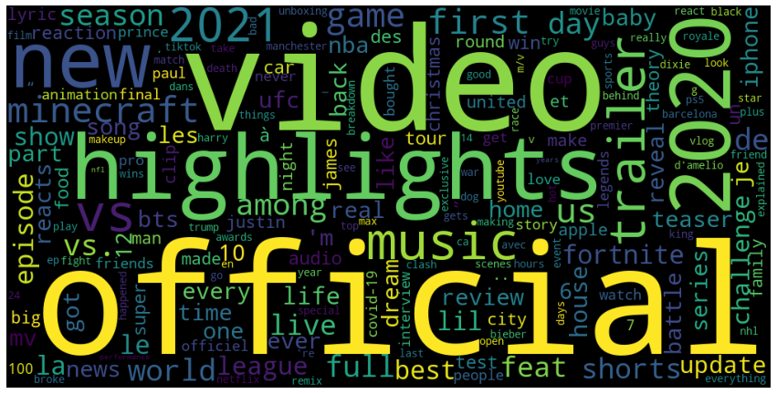
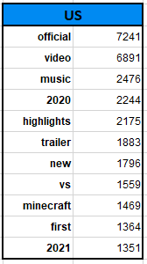
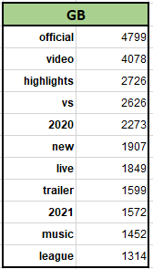
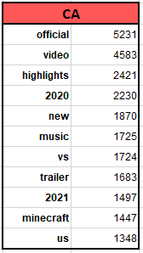
Data Analysis
x
YouTube Trending Video Title Key words
US
GB
CA
Notes:
We have been trying to observe some interesting patterns amongst trending videos in three different countries. Interestingly, the words ‘official’, ‘video’, ‘music’ and ‘highlights’ ranked on the top in all three countries. This apparently shows some pattern in YouTube videos, actually, we can easily expect that a lot of people are searching for singers' official music videos or highlights from the shows.

Slide 17

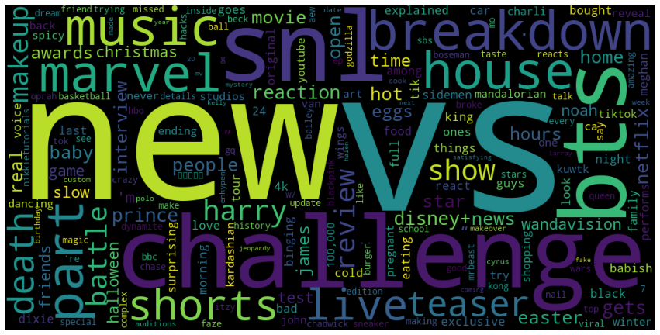
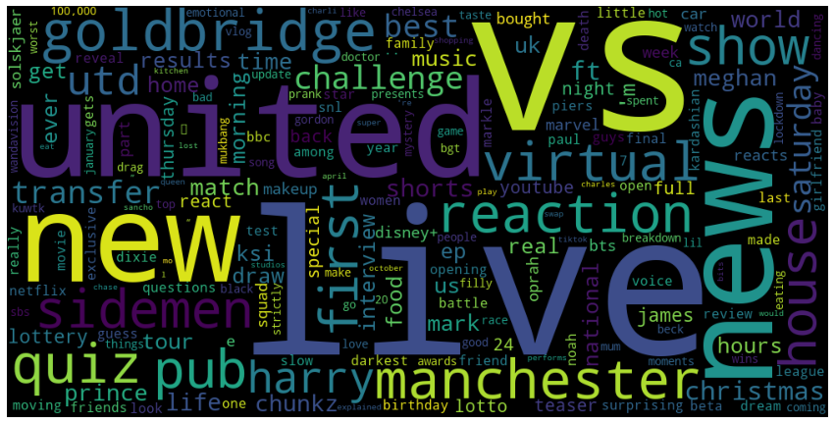
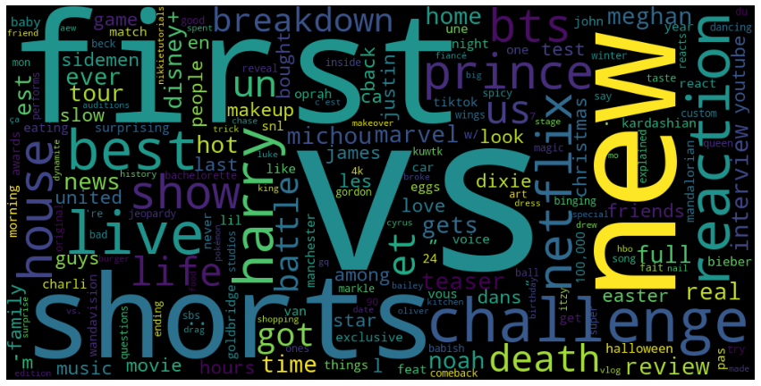
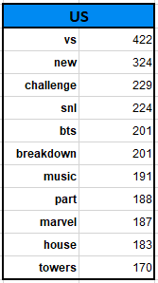
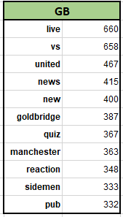
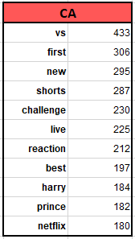
Data Analysis
x
Entertainment Category - Title
US
GB
CA
Notes:
And it shows similar patterns in tags too here. Also, we found a word nightmare but weren’t really sure how to interpret those keywords.

Slide 18
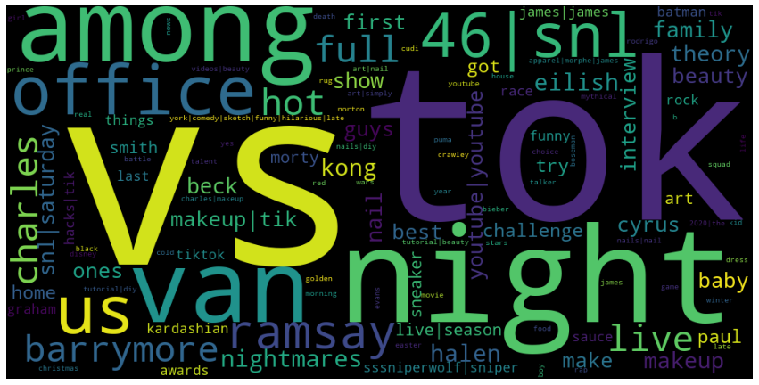
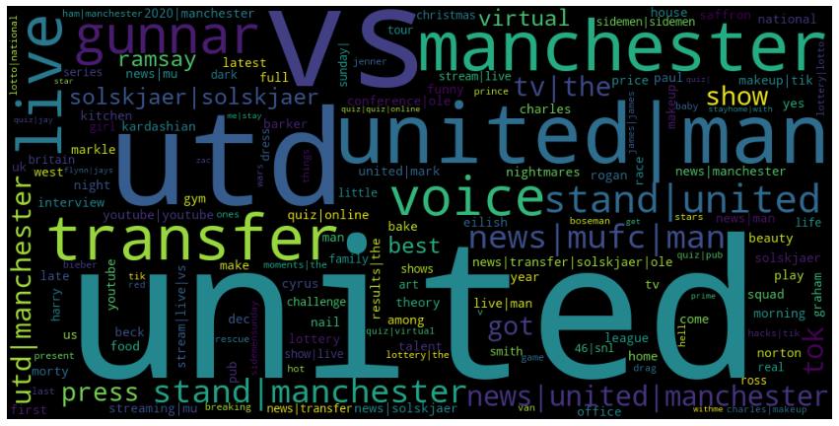
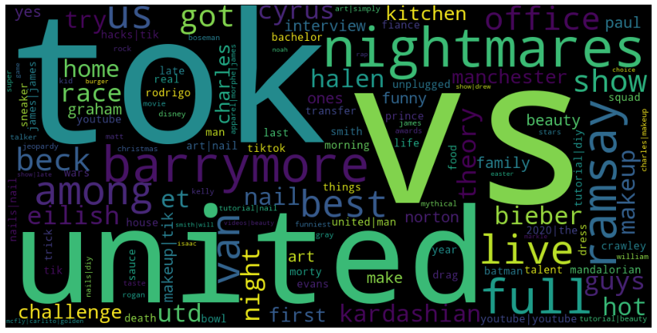
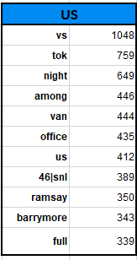
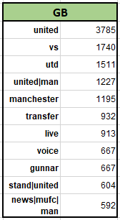
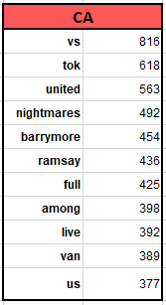
Data Analysis
x
Entertainment Category - Tags
US
GB
CA

Slide 19


Data Analysis
x
Entertainment Category - Tags
Canada
Prince Harry Arrives In Canada
To Rejoin Meghan Markle
And Baby Archie
Notes:
We have seen there were Keywords ‘Prince Harry’ who used to be a prince in the UK, and we were curious why he was ranked on Canada Entertainment Video Category. Actually, we were able to find one of the headlines ‘Prince Harry Arrives In Canada To Rejoin Meghan Markle And Baby Archie’. Then we realized that Prince Harry’s immigrant in Canada has been a huge issue in Canada.

Slide 20

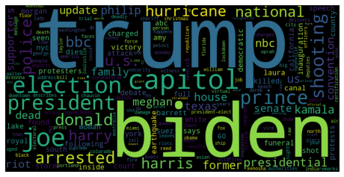
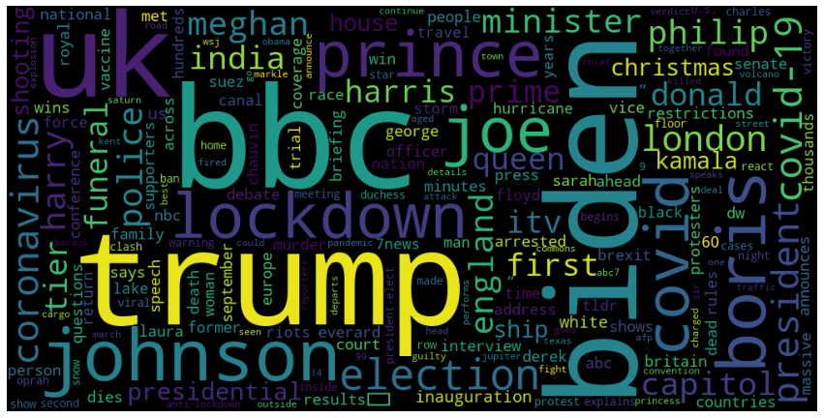
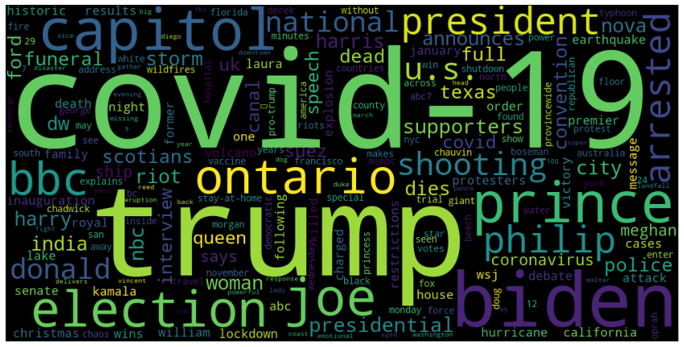
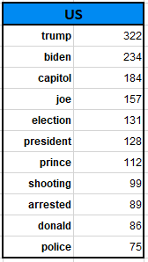
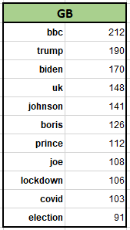
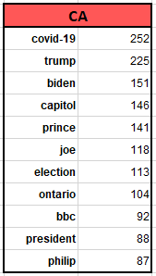
Data Analysis
x
News Category - Title
US
GB
CA
Notes:
Move on to News Category, which shows more distinctive patterns one another, which are already be expected. Recent 1.5 years all three countries were paying attention to the US election and the U.S shows some interesting words such as shooting, arrested, and police.

Slide 21
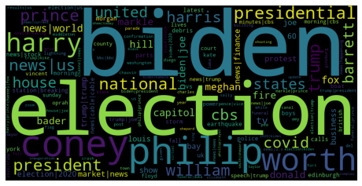
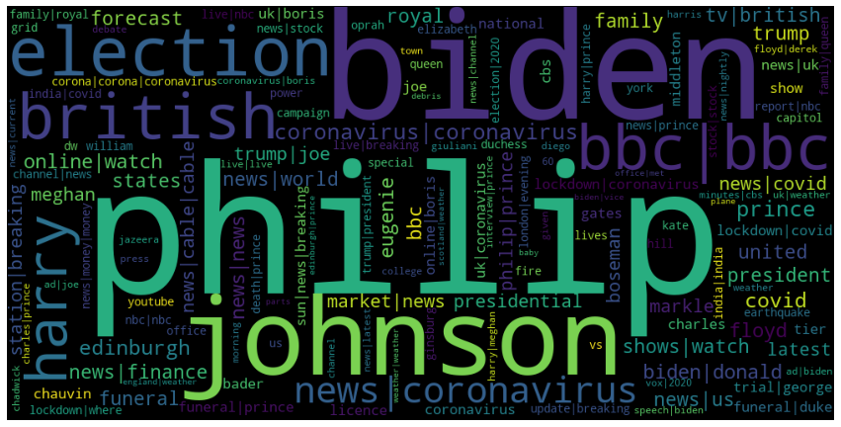
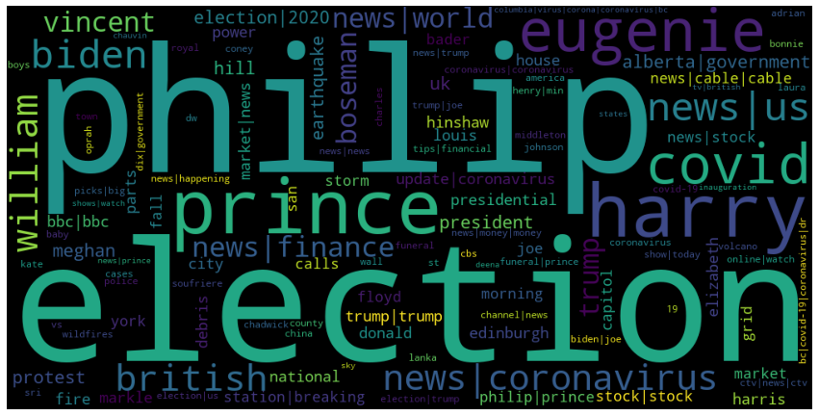
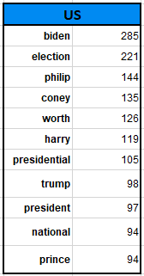
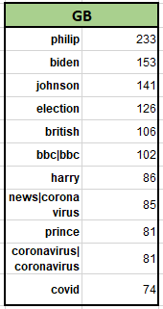
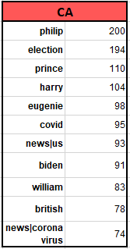
Data Analysis
x
News Category - Tags
US
GB
CA
Notes:
In the tags, there was the word ‘coney’ which we were not sure about. And UK’s distinctive interest was Covid and lockdown, Canada was still Prince Harry.

Slide 22

Data Analysis
News Category - Tags
US
Video captures fatal shooting inside Detroit Coney Island restaurant
Notes:
During the investigation phase, we found out one of the keywords in US tag category ‘coney’ was not coney island in NY but the one of the restaurant name in Detroit. In fact, there was a shooting in Detroit Coney Island restaurant. Here is one of the video title which is “Video captures fatal shooting inside Detroit Coney Island restaurant”.

Slide 23


Conclusion
z
Challenge
Potential Further Research
Language barrier
Analysis of non-English speaking countries
Size of dataset
Profit analysis of channel, tag, category type and average profit from views
Using single words can bias (N-gram)
Description analysis
Understanding countries background
Video thumbnail analysis
Notes:
Through this process, there were certain challenges and potential areas to improve on our projects. First of all, because of the language barrier, we had to split into only English-speaking countries. Especially, the textual analyst cannot just use a translator but also should understand the structure of the languages so that be able to distinguish stop words and keywords.
Second, since the size of the dataset was too large, it took some time to run through all the codes every time. Good maximum sample size is usually around 10% of the population, therefore, we could have done the random sampling to minimize the crash, especially, on my laptop
Third, there were some word base pairs according to the application but our codes were not able to collect from a text of speech corpus such as Among Us or Saturday Night Live. In this case, we later realized could have used function ‘n-grams’.
Last but not least, we realized to have a certain level of understanding also could be really helpful to analyze the text, for example, there was a keywords nightmares in the Canada category, but we were not able to figure out whether it really means the words meaning itself of there was a show or other else. Furthermore, to analyze other language.

Slide 24





Conclusion
Similarities in trending videos
Enhance understanding
of countries background
65% of people are visual learners-- benefit individual content creators and businesses to enrich video contents
(i.g. title length, tag length, publish time, etc. )
Notes:
If you want to improve your YouTube channel’s performance, you need to understand your data. The plus side of all of this data is you can dive deep into your videos’ performance and understand what’s happening on a granular level.65% of people are visual learners. Understanding these statistics not only helps individual creators to create better contents, but can also benefit businesses to target main audience or target contents. According to Forbes, correctly targeted visual contents increase the amount spent by a customer by 31%, allow business to raise their prices by 11%, and improve the level of trust with 92% of consumers who research the business.

Slide 25
Thank Y u!

Slide 26
Q&A

